Slide 1
LU Disability and Inclusive Practice Service: Disabled Students Allowance (DSA) Workshop
May 2026
Notes:
Main presentation title slide.

Slide 2
Content
Introduction
  Disability and Inclusion Service
What is DSA?
Who can get it?
How do I apply?
Having the right evidence
Filling in the form
Organising your support
Problems?
Resources

Slide 3
Introduction
Notes:
Section title slide.

Slide 4
LU Disability and Inclusion Service
disability@lancaster.ac.uk
LU Disability and Inclusive Practice Service
  Inclusive Learning and Support Plans (ILSPs)
  Reasonable adjustments
  Medical evidence
  DSA
  Assistive software

Slide 5
What is Disabled Students Allowance (DSA)?

Slide 6
DSA
If you are a UK student, you may be entitled to receive Disabled Students Allowances (DSA) from your funding body.
DSA is not means tested and does not need to be repaid.
The allowance is dependent on your needs and will be paid directly to providers.
DSA can pay for things like academic mentoring support, assistive technology, and additional study costs incurred because of your disability.

Slide 7
Funding bodies
Student Finance England (SFE)
Student Finance Wales (SFW)
Student Finance Northern Ireland (SFni)
Student Awards Agency Scotland (SAAS)

Slide 8
Who can get it?: Eligibility

Slide 9
PG Dip Social Work
Participants can apply for DSA
Year 1
  Yes
Year 2
  No DSA as not registered with Lancaster University
  Local authority and Frontline responsible for adjustments
Year 3
  Yes (on a case by case)
  Participants must reapply for each year

Slide 10
Eligiblity
You can apply for Disabled Students’ Allowance (DSA) if you live in England and have a disability that affects your ability to study, such as a:
  specific learning difficulty, for example dyslexia or ADHD
  mental health condition, for example anxiety or depression
  physical disability, for example if you have to use crutches, a wheelchair or a special keyboard
  sensory disability, for example if you’re visually impaired, deaf or have a hearing impairment
  long-term health condition, for example cancer, chronic heart disease or HIV
You must also:
  be an undergraduate or postgraduate student (including Open University or distance learning)
  qualify for student finance from Student Finance England*
  be studying on a course that lasts at least a year

Slide 11
Unsure?
If you are unsure if you might be eligible then please contact disability@lancaster.ac.uk
Review medical evidence
Review completed DSA application form
Advice and guidance on process
Advice and guidance on Inclusive Support without a diagnosis

Slide 12
How do I apply?

Slide 13
Application Process
Complete an application form and gather suitable medical evidence
Send the form and evidence to your funding body
Receive eligibility letter
If eligible:
Invited to a needs assessment
Receive assessment report
Receive awards letter
Arrange and organise your support

Slide 14
Application Process (up to 14 weeks)
Application form
Suitable medical evidence
Send the form and evidence to your funding body
Eligibility letter
Assessment
Assessment report
Awards Letter
Arrange your support

Slide 15
Suitable Medical Evidence

Slide 16
Medical Evidence
Medical evidence is expected to cover the following points:
  Name of the condition or impairment
  Date of diagnosis and how long it has lasted/is likely to last
  The main effects (including the severity) of the impairment on studies and carrying out normal day-to-day activities including symptoms

Slide 17
Medical Evidence
Your medical evidence must be:
  Provided by a qualified medical professional (e.g. GP, consultant, specialist nurse) or other suitable professionals (such as Educational Psychologists, Audiologists etc.)
  On headed paper with the professional's contact details
  As up-to-date as possible
  Clearly state that your diagnosis has a substantial and long-term negative impact on your ability to do normal daily activities

Slide 18
Medical Evidence
Most conditions evidenced by GP/doctors letter
  Or other appropriate healthcare professional
Specific Learning Difficulties (SpLD)
  Dyslexia, Dyspraxia, Dyspraxia, Dyscalculia etc.
  Educational Psychologist Full Assessment Report
    Appropriately trained Specialist Assessor
Unsure? Email disability@lancaster.ac.uk

Slide 19
No evidence?
Cannot apply without evidence
Request a letter from your GP or doctor
  Guidance for Medical Professionals
DSA Evidence Form
SpLD Assessment
  suitabilitysupport@thefrontline.org.uk

Slide 20
What types of support might I get?

Slide 21
Assistive Software
Examples only, as recommendations are made on an individual basis based on your need and evidence.

Slide 22
Assistive Software
Speech to Text
Text to Speech
Speak aloud your work and have it translated into text.
Examples:
  In-built Microsoft Office and Mac OS functions
  Read and Write
  ClaroRead
SpLD, physical disability, fatigue, migraines etc.
Highlight text to be converted to audio.
Examples:
  In-built Microsoft Office and Mac OS functions
  Read and Write
  ClaroRead
SpLD, physical disability, fatigue, migraines etc.

Slide 23
Assistive Software
Screening Masking/Tinting
Spell Check/Thesaurus
Allows a user to change their background colour or mimic a colour overlay.
Examples:
  Read and Write
  Claro
SpLD, visual fatigue, some Neurodiverse conditions.
Allows a user to check their work and grammar.
Examples:
  Read and Write
  In-built Microsoft Office and Mac OS features
  Grammarly
SpLD, fatigue, brain fog, some Neurodiverse conditions.

Slide 24
Assistive Software
Screen Reader
Dictation/Lecture recording Software
Useful for those with a visual impairment or for those who may not be able to view a screen, use with the computer and websites or documents, by turning the text in speech
Visual Impairment, severe migraines, multiple sclerosis, stroke, physical conditions, Functional Neurological Disorders.
Useful for getting notes typed up by using speech in a timely and efficient way.
SpLD, physical conditions, fatigue, brain fog, mental health and some neurodiverse conditions.

Slide 25
Assistive Software
Organisational
Time Management
Such as Mindmapping to help users organise their thoughts and essays.
Mental health, ASC, ADHD, fatigue.
To help users plan their time and track assignments/deadlines
Mental health, ASC, ADHD, fatigue, dyspraxia.

Slide 26
Human Support or Non-Medical Help (NMH)

Slide 27
Specialist Study Skills Tutor and Mentor
Specific Learning Difficulty (SpLD)
Mental Health (MH)/ADHD/Autistic Spectrum Condition (ASC)
Specialist 1:1 Study Skills Support
Support students by helping the to develop skills, techniques and tools to help with:
  Processing and retaining information
  Attention and numeracy difficulties
  Planning, time management and organisational skills
  Note taking tips
  Literature search and research skills
  Proof reading skills
  Revision methods
Support students by helping the to develop skills, techniques and tools to help with:
  Managing the transition to university and changes
  Social situations and living with others
  Working on communication skills
  Studying at university
  Managing study and social life
  Where to get support at university
  Presentation preparation

Slide 28
Equipment

Slide 29
Equipment
Laptop or Headset
Ergonomic Chair or Desk
You may be recommended equipment to help with studies.
A laptop may be recommended if you have also been recommended software but your current laptop cannot run it effectively.
A headset may be recommended if you have been recommended software that requires clear speech or you to listen to speech.
You may be recommended a specialist chair depending on your needs and condition.
You may be recommended a specialist desk depending on your needs and condition.

Slide 30
DSA Application Form

Slide 31
Student Finance England (SFE)
Full DSA Form from your Funding Body
  If you are a UK resident and have lived in England for past 3 years, likely to be SFE
  Full form for your academic year
    i.e. If you started the programme in July 2025 complete the 24/25 form
    i.e. If you started or are due to start programme in July 2026then complete the 25/26 form.

Slide 32
SFE DSA Form: Section 1

Slide 33
Personal Details Section
Page 2
  ‘Postgraduate course – Complete this form’
Personal Details Section
  Name, address etc.
  Place of birth and nationality
  Passport status and number
  Student loan information
  Armed forces

Slide 34
SFE DSA Form: Section 2

Slide 35
Other Financial Support
Ignore a1, a2 and a3
B1 - No
B2 - No
B3 - No
C1 - No
This is because you are not getting NHS, Department of Health or other Disability-related funding

Slide 36
SFE DSA Form: Section 3

Slide 37
Residence
You will need to complete this individually.
If you are unsure what a question means then you can contact either disability@lancaster.ac.uk or your Funding Body using the details on your form.

Slide 38
SFE DSA Form: Section 4

Slide 39
About your course and university or college
A - University
  Lancaster University
  Bailrigg
  Lancaster
  LA1 4YW
B - Course Details
  Course Name
    Pg Dip Social Work delivered by Frontline

Slide 40
About your course and university or college
B - Course Details
  Qualification
    PG Dip
  Course start date
    07/2026
  Course end date
    08/2027
  Course length
    1 year
  Year of course
    Year 1

Slide 41
About your course and university or college
C – Term Details
  Term 1 – Work Placement
  Term 2 – Work Placement
  Term 3 – Work Placement
D – Placement
  No

Slide 42
About your course and university or college
E – Where will your placement be?
  UK
  Add address if you know it
E - Paid or unpaid?
  Unpaid
  If unpaid – which type?
    a Local Authority carrying out its duties relating to health, welfare or caring for children and young people, a voluntary organisation providing facilities or carrying out similar activities or a Local Authority acting in the exercise of public health functions in the UK;

Slide 43
SFE DSA Form: Section 5

Slide 44
Your university or college
Leave blank
They will contact LU Disability and Inclusion Service directly for this information instead

Slide 45
SFE DSA Form: Section 6

Slide 46
Your Disability
A - Please give the name or diagnosis and provide photocopied evidence of your disability.
  Add diagnosis or name of condition
B- Consent to share
  I agree that Student Finance England and the Disability and Inclusion Service at my university or college may exchange information about my application for DSA where this is necessary to make sure I get the help I need.
    Your choice but is helpful so we can chase up your application on your behalf, if needed.

Slide 47
SFE DSA Form: Section 7

Slide 48
Your UK bank or building society account details
You need to complete
It is very unlikely you will get money into your account as mostly it will go directly to the suppliers of your recommended support

Slide 49
Terms and Conditions; Signature; Checklist

Slide 50
T&Cs, Sign and Check
You need to read these
If you agree with the T&Cs then sign and date
Review the checklist before sending
  However you don’t need to have section 5 completed, it can be sent without this detail from LU

Slide 51
Send the DSA Form and Evidence to your Funding Body

Slide 52
Post or Email
Once you have completed this form, and signed and dated the terms and conditions, please return it to:
Student Finance England
PO Box 210
Darlington
DL1 9HJ
You can also return your completed form and evidence to the DSA team by email at dsa_team@slc.co.uk
(correct for SFE as of 20/11/2025)

Slide 53
Recap on next steps

Slide 54
Next Steps
Eligibility letter
  Follow up with your funding body if you haven’t had anything in 2-4 weeks from sending application
  Email or post
  Details how to book an assessment
Book your assessment
Attend your assessment
Assessment Review Summary
SFE Awards letter
  Organise your support, training and/or equipment

Slide 55
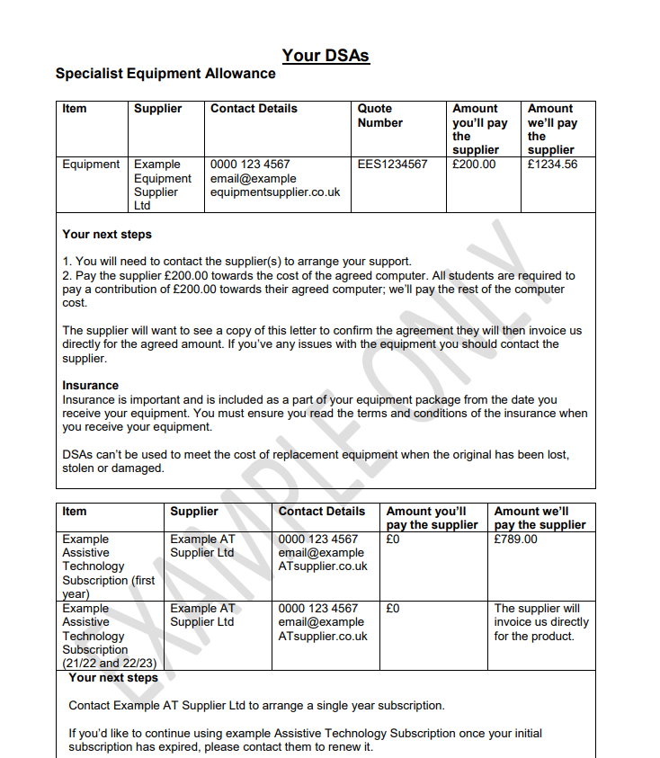

Slide 56
Resources

Slide 57
Inclusive Support
Inclusive Learning and Support Plan (ILSP)
disability@lancaster.ac.uk
LU Disability and Inclusive Practice Service webpage for Approach Social Work
Assistive Software
  Assistive tools and technologies | ASK - Lancaster University
Wellbeing:
  Mental health & wellbeing line | ASK - Lancaster University
  Silvercloud
Learning Developer
  learningdevelopmentfl@lancaster.ac.uk

Slide 58
FAQs

Slide 59
Frequently Asked Questions
What if I’m not eligible?
  Email disability@lancaster.ac.uk
What if I’ve not heard back about my DSA application?
  Contact your Funding Body
  Contact LU Disability and Inclusion Service
How do I arrange my DSA support?
  Follow instructions on your awards letter
  If you are unsure, email disability@lancaster.ac.uk
What support is available?
  Individual basis but could be; software, equipment, non-medical help etc.
Who do I contact?
  Your Funding Body
  disability@lancaster.ac.uk

